Slide 1
Patient Positioning System
Replacing Laser Systems in MRI, CT, & LINAC Environments
A Universal Point Cloud Approach
Authors: Robin Somers - Patrick Koekkoek - Vijani Alenthuge - Abdullah Türkkani - Wadea Ai-Wossabi

Slide 2
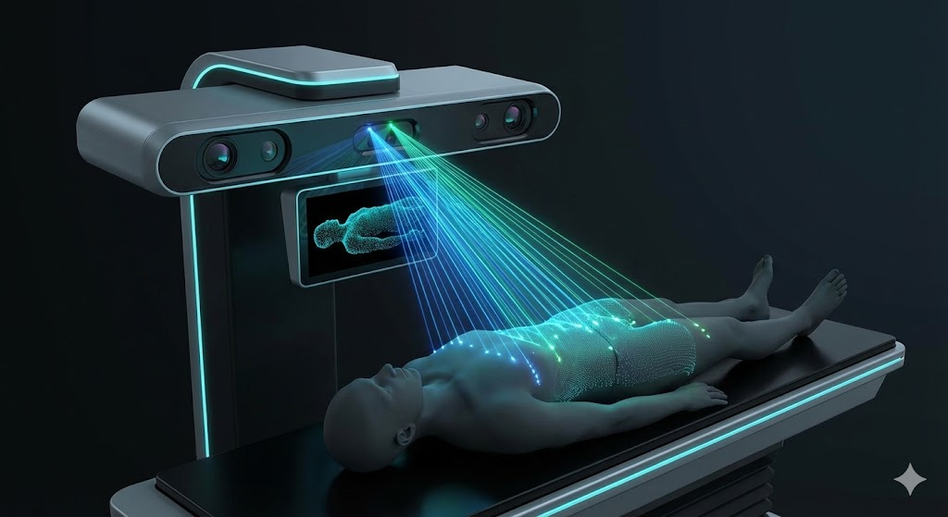

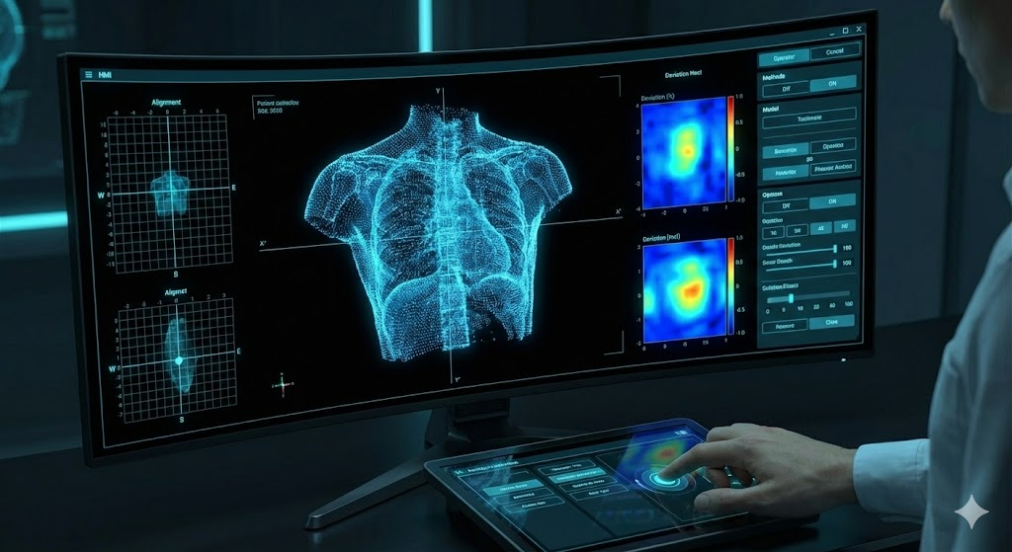
The Universal Approach
Sensor Unit
PSU
HMI

Slide 3
The Unknowns
Data Requirements
Accuracy
Noise
Uniformity
Density
Algorithm Requirements
Speed
Accuracy
Robustness

Slide 4
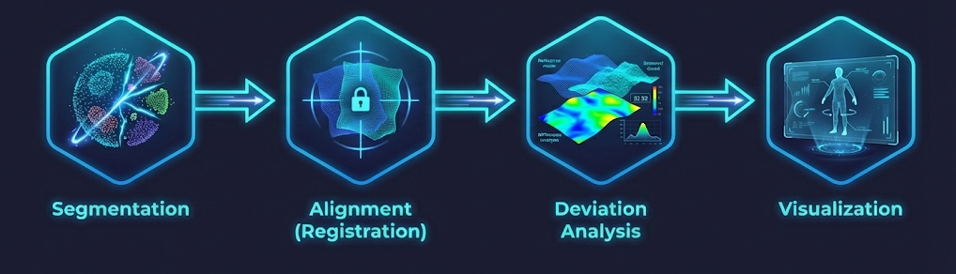
The Software

Slide 5
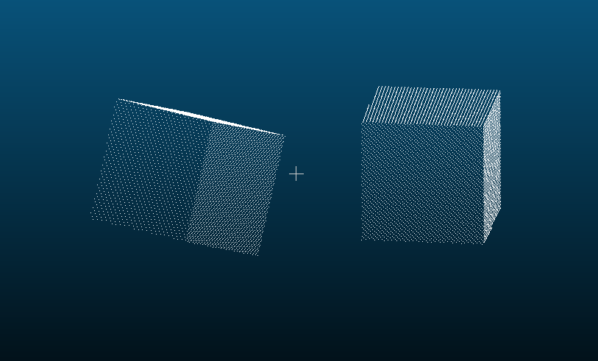
Predicting?

Slide 6
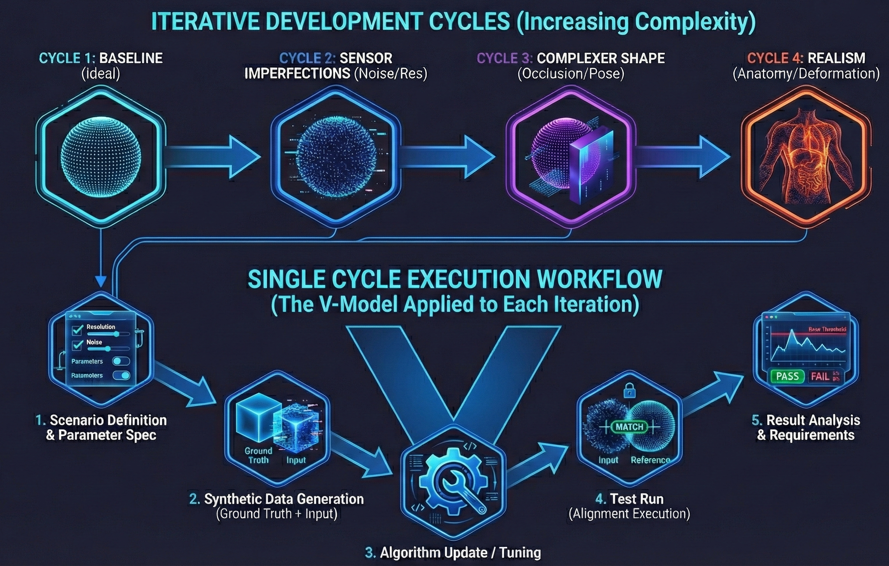
The Approach

Slide 7
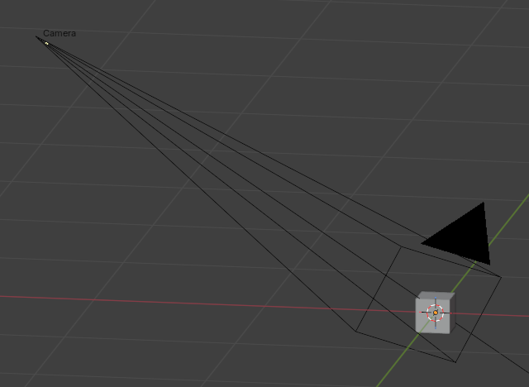
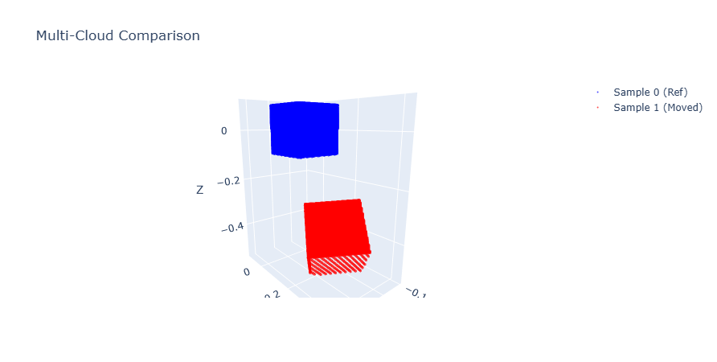
The Data
Blender
Python
CloudCompare (checking)

Slide 8
Thank You
Towards tattoo-less, automated patient positioning

